Slide 1
Unit 4: Machine Learning and Modeling Techniques– Decision trees/random forest
Cuny LaGUardia community college

Slide 2
What are trees?
Imagine you’re playing a game outside and you always invite your best friend to play with you. Sometimes they decide they want to come and play, other times they don’t. You decide you want to keep track of when your friend decides to play – maybe there’s a pattern? Maybe certain conditions impact their decision to come play? Maybe the weather … or temperature, etc.

Slide 3
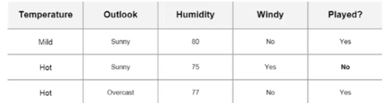
What are trees?
For example, you start charting your findings

Slide 4
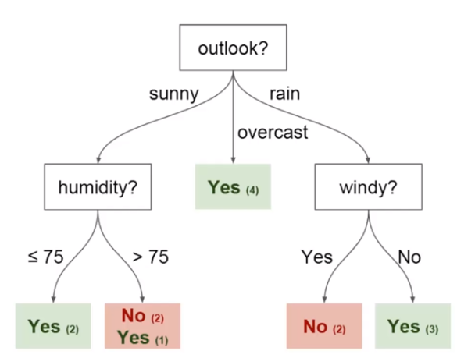
What are trees?
You want to use your collected data to help predict whether your friend will come play or not.
A decision tree is a useful method, as shown ->

Slide 5
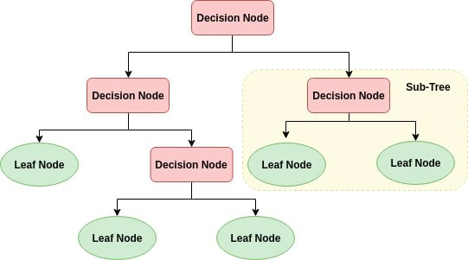
What are trees?
A simple Tree structure
Decision Node
Leaf Node

Slide 6
What are trees?
A decision tree consists of various parts, such as:
Nodes:
Split for the value of a certain attribute
Edges
Outcome of a split to next node
Root
The node that performs the first split
Leaves
Terminal nodes that predict the outcome

Slide 7
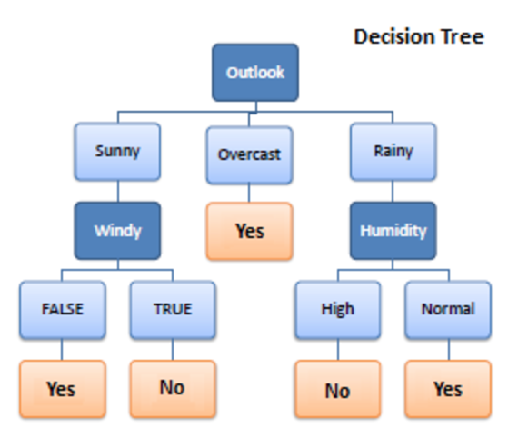
Decision trees and random forest
“Decision trees are a type of model used for both classification and regression. Trees answer sequential questions which send us down a certain route of the tree given the answer. The model behaves with “if this than that” conditions ultimately yielding a specific result.” -towardsdatascience

Slide 8
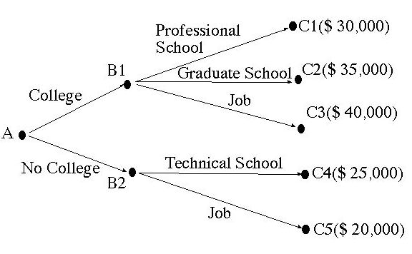
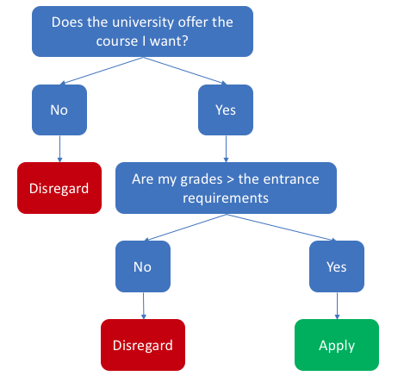
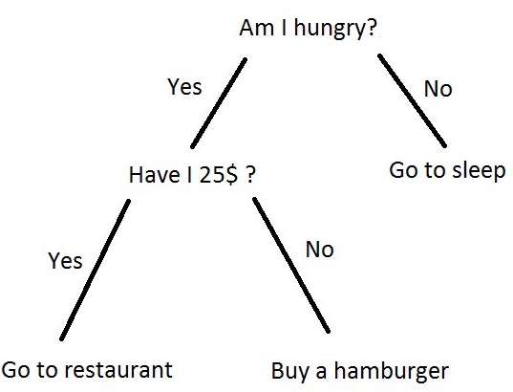
Make a decision tree
Spend 10-15 mins making a decision tree on paper. Understanding the basics behind how the machine learning model will help you to understand what exactly the model is doing.

Slide 9
Decision trees
https://www.youtube.com/watch?v=DCZ3tsQIoGU
Pay close attention to 6:30 and onwards

Slide 10
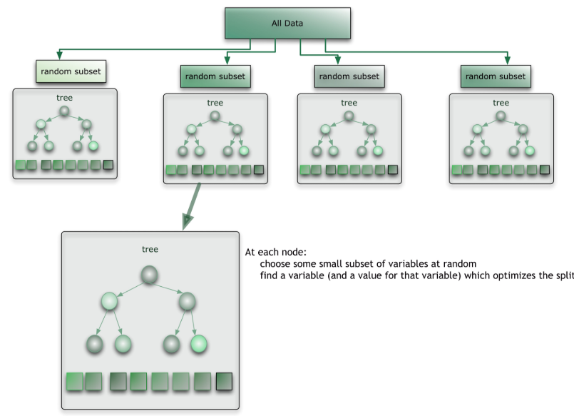
Random forest
“A random forest consists of multiple random decision trees. Two types of randomnesses are built into the trees. First, each tree is built on a random sample from the original data. Second, at each tree node, a subset of features are randomly selected to generate the best split.”

Slide 11
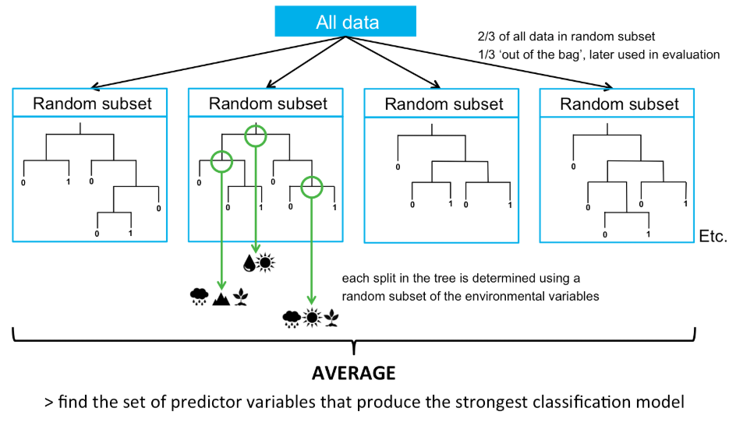
Random forest example

Slide 12
Random forest
https://www.youtube.com/watch?v=D_2LkhMJcfY
What are the differences between a decision tree and a random forest?
Which model do you think performs better? Why?

Slide 13
Break – 15 mins

Slide 14
Datacamp free course on decision trees and random forests
https://www.datacamp.com/community/open-courses/kaggle-python-tutorial-on-machine-learning

Slide 15
Datacamp random forest tutorial in python
Visit the datacamp article/tutorial on random forests. Follow along with the article and complete the various sections
https://www.datacamp.com/community/tutorials/random-forests-classifier-python

